Slide 1
Introduction to the Machine Learning Lab
Week #6 - 16 Oct ‘24
ML Lab

Slide 2
Objective
By the end of this workshop, you will understand
What/How to:
Regression Task
Unsupervised Learning
Clustering
K-Means Clustering
PCA: Dimensionality reduction

Slide 3
Linear Regression
A regression algorithm that models the relationship between a dependent variable and one or more independent variables by fitting a linear equation to the data.

Slide 4
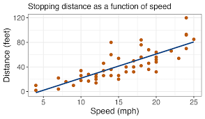
What is Linear Regression?
Linear Regression is a regression algorithm used to model the relationship between a dependent variable and one or more independent variables.
It fits a straight line (linear equation) to minimize the difference between the predicted and actual values.

Slide 5
How Linear Regression Works
The equation for a straight line is: y=mx+b (for simple linear regression).
The algorithm estimates the slope (m) and intercept (b) to best fit the data.
In multiple linear regression, there are multiple input variables (features).

Slide 6

Minimizing the Error
Linear regression minimizes the error (residuals) between predicted and actual values.
It uses a cost function like Mean Squared Error (MSE) and optimization techniques like Gradient Descent to find the best-fit line.
GRAD DESCENT

Slide 7
Applications of Linear Regression
Used in:
Predicting house prices based on features like size and location.
Forecasting sales trends over time.
Modeling the relationship between temperature and ice cream sales.
Example: Predicting house prices based on square footage.

Slide 8
Unsupervised Learning
A type of machine learning that finds hidden patterns or structures in data without labeled outcomes.

Slide 9
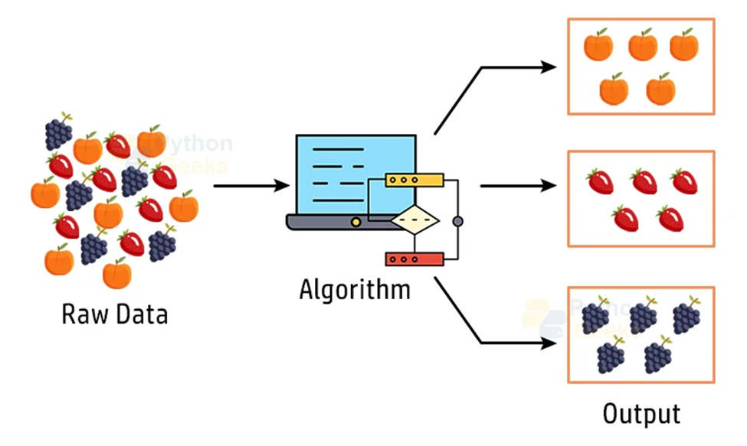
Unsupervised Learning
Unsupervised learning is a type of machine learning where the algorithm learns patterns from unlabeled data.
No explicit output or target variable is provided.
The goal is to find hidden structures in the data.

Slide 10
How Unsupervised Learning Works
The model analyzes data and identifies patterns or groupings.
It’s commonly used for clustering, anomaly detection, and association tasks.
Two main techniques: clustering and dimensionality reduction.

Slide 11
Key Algorithms in Unsupervised Learning
Clustering Algorithms:
K-Means, Hierarchical Clustering
Dimensionality Reduction:
PCA (Principal Component Analysis)
These algorithms help in identifying hidden patterns and simplifying complex data.

Slide 12
Clustering
A method of grouping similar data points into clusters where data within the same cluster are more alike than data in different clusters.

Slide 13
Clustering
Clustering is a technique in unsupervised learning that groups similar data points together.
The goal is to organize data into clusters, where data points within a cluster are more similar to each other than to those in other clusters.

Slide 14
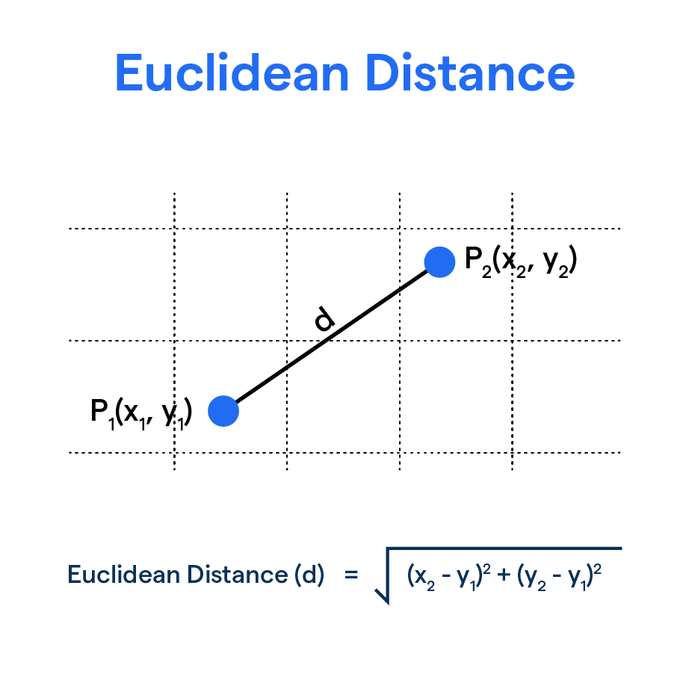
How Does Clustering Work?
Clustering algorithms analyze data and calculate similarity between data points using distance metrics (e.g., Euclidean distance).
Example of K-Means: The algorithm assigns data points to the nearest cluster center, recalculates cluster centers iteratively until convergence.

Slide 15
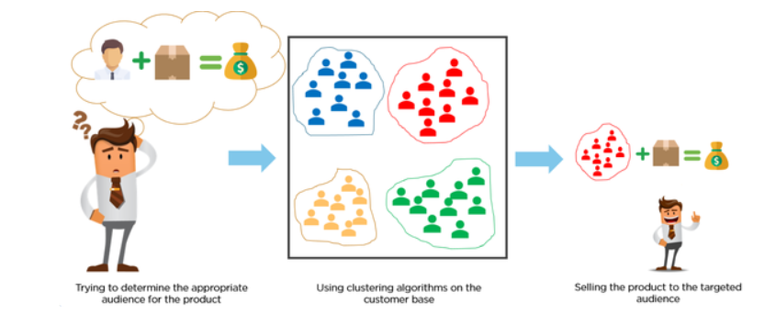
Applications of Clustering
Clustering is widely used in:
Customer segmentation
Market analysis
Image compression
Document organization
Example: Grouping customers based on purchase behavior for targeted marketing.

Slide 16
K-Means Clustering
A popular clustering algorithm that partitions data into K clusters by minimizing the distance between points and their assigned cluster centroids.

Slide 17
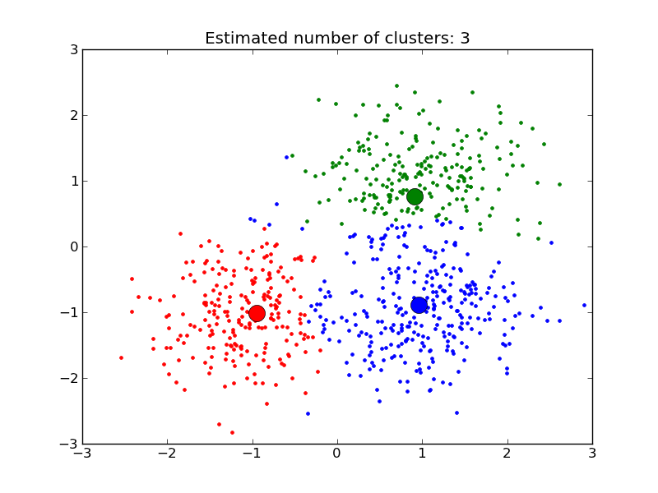
K-Means Clustering
K-Means is a popular partition-based clustering algorithm.
It divides data into 'K' distinct clusters, where each data point belongs to the cluster with the nearest mean (cluster center).
The algorithm is iterative, refining clusters with each step.

Slide 18
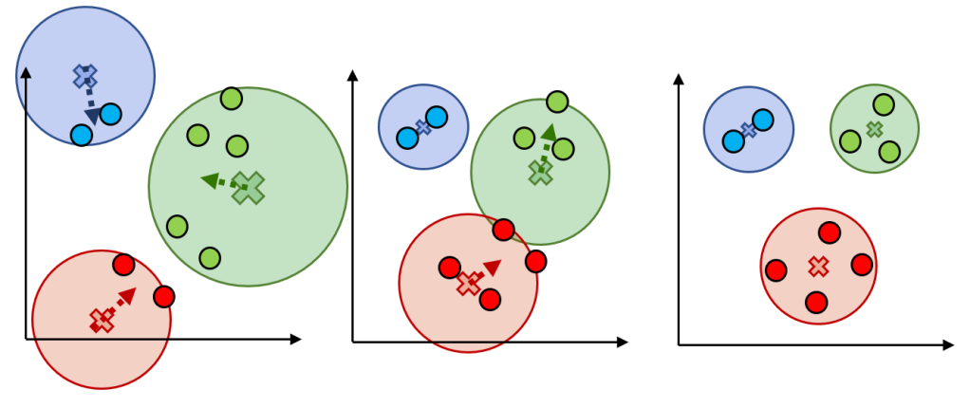
How Does K-Means Work?
Choose the number of clusters (K).
Initialize K random centroids (cluster centers).
Assign each data point to the nearest centroid.
Recalculate centroids based on the mean of assigned points.
Repeat steps 3-4 until centroids no longer change.

Slide 19
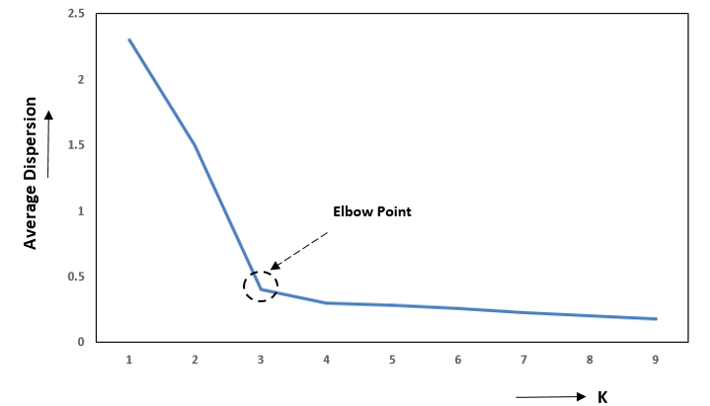
How to Choose K?
Elbow method: Plot the sum of squared errors (SSE) for different values of K.
The 'elbow' point indicates the optimal K, balancing simplicity and fit.
Visual example: Plot SSE against K to identify the elbow point.

Slide 20
Applications of K-Means
Used in market segmentation, image compression, and document classification.
Example: Customer segmentation in marketing, grouping users with similar behaviors.

Slide 21
Feature Scaling
Feature scaling is the process of normalizing or standardizing the range of features in a dataset to ensure that all features contribute equally to a machine learning model's performance.

Slide 22
What is Feature Scaling?
Feature scaling is a technique to standardize the range of independent variables or features of data. It ensures all features contribute equally to the model's performance.
Importance:
Different scales of features can impact machine learning algorithms.
Makes optimization faster and improves accuracy.

Slide 23
Common Methods of Feature Scaling
Min-Max Normalization (0 to 1): Formula: X′= (X−Xmin)/(Xmax−Xmin)​​
Rescales data to a fixed range.
Suitable for algorithms like K-Nearest Neighbors.
Standardization (Z-Score Normalization): Formula: X′=(X−μ)/σ
Centers the data around zero with unit variance.
Ideal for algorithms assuming Gaussian distribution (e.g., logistic regression).

Slide 24
When to Use Feature Scaling?
Algorithms That Need It:
Distance-based algorithms (KNN, SVM).
Gradient-based algorithms (logistic regression, neural networks).
Algorithms That Don’t Need It:
Tree-based algorithms (Decision Trees, Random Forest).

Slide 25
Principal Component Analysis (PCA)
A dimensionality reduction technique that transforms data into a lower-dimensional space while retaining the most important variance.

Slide 26
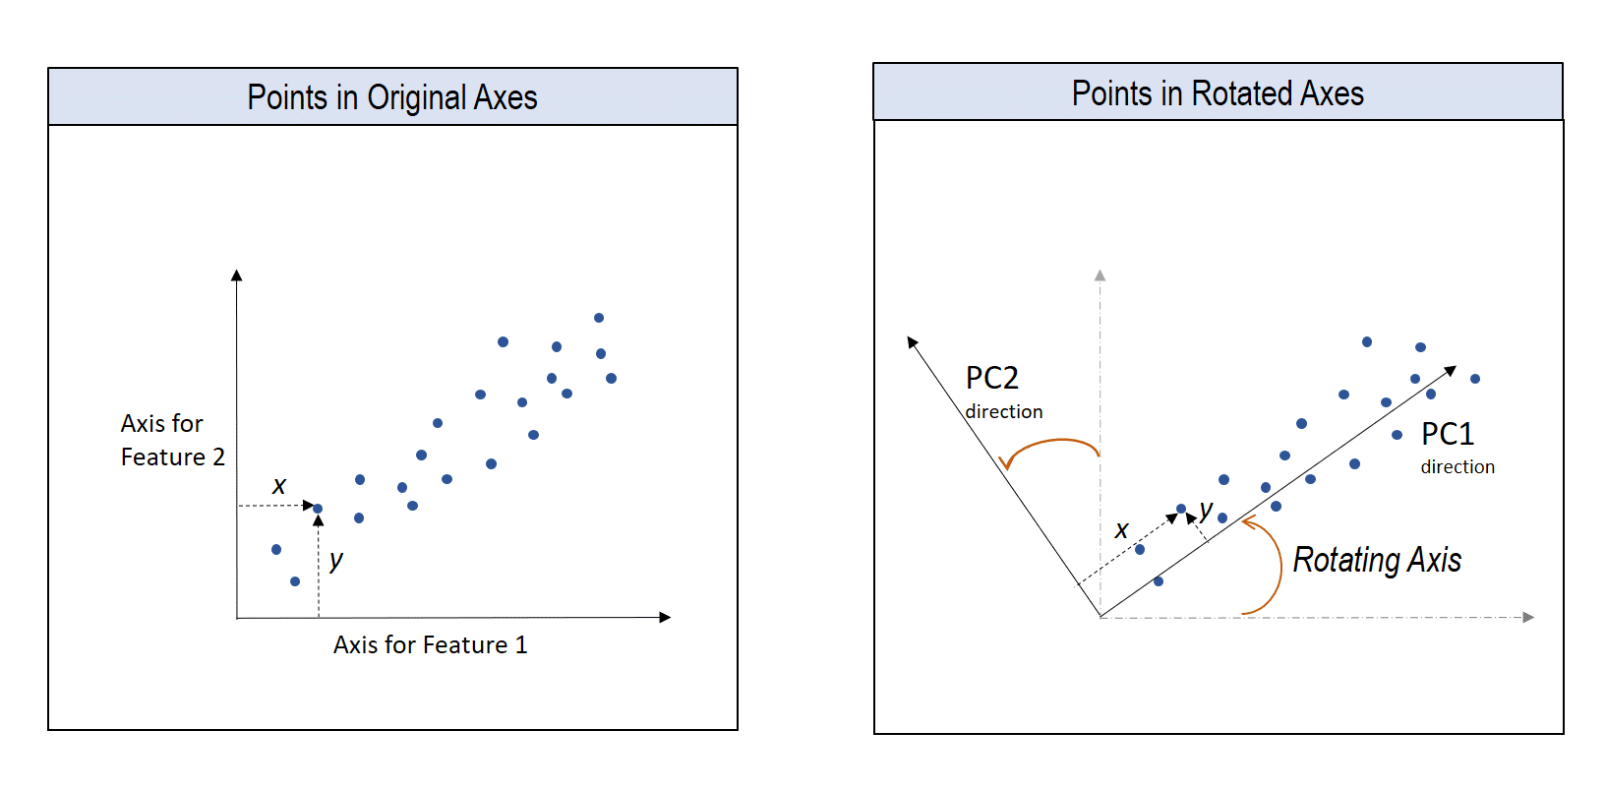
What is Principal Component Analysis (PCA)?
PCA is a dimensionality reduction technique used to simplify large datasets.
It transforms data into a new coordinate system where the greatest variance is captured in the first few principal components.
Helps in reducing noise and computational complexity while retaining essential patterns.

Slide 27
How Does PCA Work?
Standardize the dataset (ensure each feature has equal weight).
Calculate the covariance matrix of the features.
Compute the eigenvectors and eigenvalues of the covariance matrix.
Select the top principal components (eigenvectors with highest eigenvalues).
Transform the data into the new feature space.

Slide 28
Applications of PCA
PCA is used for:
Dimensionality reduction in large datasets.
Image compression.
Visualizing high-dimensional data in 2D/3D.

Slide 29
Additional resources
Linear Regression
Clustering Algorithms
Unsupervised Learning
K-clustering
PCA

Slide 30
Group Picture!

